Slide 1
Employee Data Analysis using Excel
STUDENT NAME: KRITHIKA.S
REGISTER NO: 312214869
DEPARTMENT: COMMERCE
COLLEGE: ANNAI VEILANKANNI’S COLLEGE FOR WOMEN

Slide 2
Employee performance using excel
PROJECT TITLE

Slide 3
AGENDA 1.PROBLEM STATEMENT 2.PROJECT OVERVIEW 3.END USERS 4.OUR SOLUTION AND PROPOSITION 5.DATASET DESCRIPTION 6.MODELLING APPROACH 7.RESULTS AND DISCUSSION 8.CONCLUSION

Slide 4
PROBLEM STATEMENT: 1.Easy data management 2.Data organization 3.Automation 4 Easy of use 5.Versatility 6.Collaboration

Slide 5
PROJECT OVERVIEW
*PROJECT SCOPE
*OBJECTIVE
*DATA ANALYSIS
*KEY FINDINGS
*STRATEGIC RECOMMENDATIONS
*OUTCOME GOALS
‹#›

Slide 6
WHO ARE THE END USERS 1.EMPLOYEES 2.ORGANISATION 3.FIRM 4.BUSINESS 5.MANAGER/SUPERVISOR 6.HUMAN RESOURCES 7.CUSTOMERS

Slide 7
OUR SOLUTION AND ITS VALUE PROPOSITION: *FILTERING REMOVE MISSING VALUE. *CONDITIONAL FORMATING BLANKS PIVOT. *TABLE SUMMARY OF EMPLOYEE PERFORMANCE. *FORMULAS -IF CONDITION. *GRAPHS - FINAL REPORT.

Slide 8
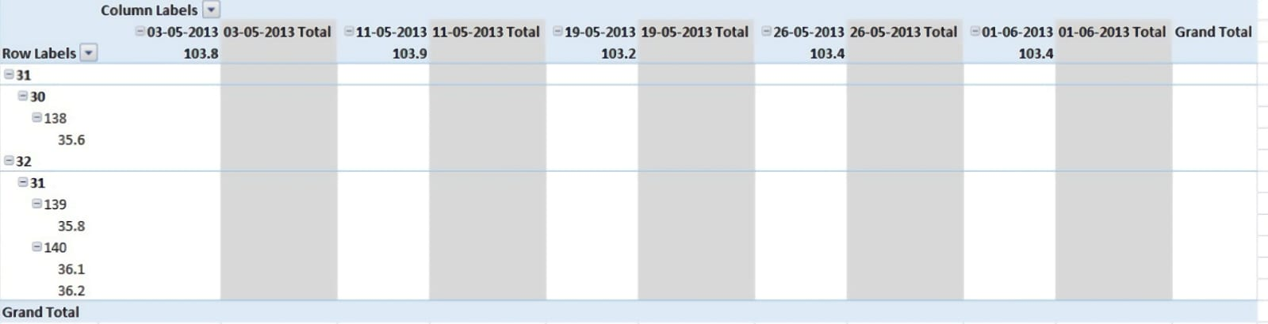
Dataset Description

Slide 9
MODELLING APPROACH: *DATASET *FEATURE SELECTION *DATA CLEANING *FORMULA *PIVOT TABLE *CHARTS AND REPORTS *LICENSING/TOOLS

Slide 10
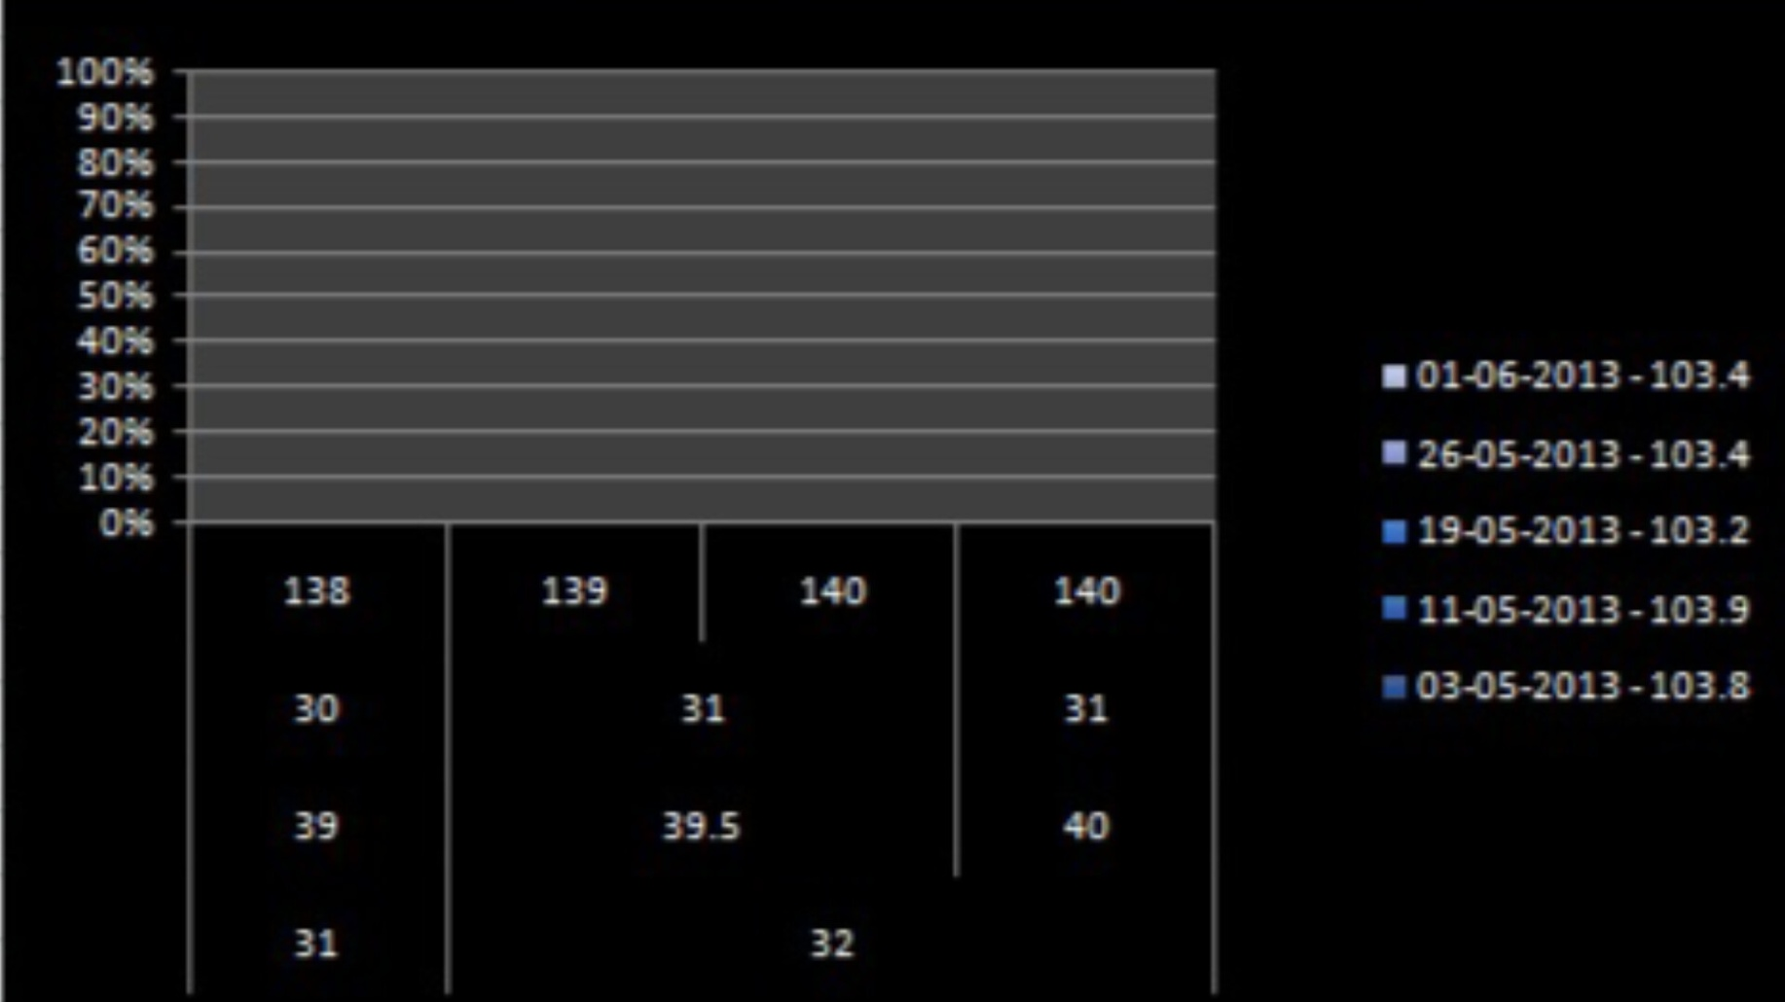
RESULTS
10

Slide 11
Conclusion IN THIS PRESENTATION,WE CONCLUDE *DATA SHOWS CONSISTENCY AND STABILITY ACROSS OBSERVED PERIODS. *OVERALL STABILITY SUPPORTS STRATEGIC DECISION TO MAINTAIN A COMPETITIVE EDGE.

